Slide 1
Public Key Infrastructure (PKI) & Single Sign-On (SSO)
Lkhagva-Ochir, 202339663

Slide 2
Contents
•Introduction to PKI
•How PKI works
•PKI Case Study – DTGOV
•Introduction to SSO
•How SSO works
•SSO Case Study – ATN
•Comparison: PKI vs SSO
•Summary & Q&A

Slide 3
What is PKI?
The Public key infrastructure (PKI) is the set of hardware, software, policies, processes, and procedures required to create, manage, distribute, use, store, and revoke digital certificates and public-keys.
•Framework of protocols and practices for managing public keys:
•Associates public keys with owners using digital certificates
•Certificates are signed by trusted Certificate Authorities (CAs)
•Used in HTTPS, digital signatures, VPNs, and secure email

Slide 4
How PKI works
User creates a public/private key pair
Public key is sent to a Certificate Authority (CA)
CA verifies identity and signs a digital certificate
Revocation
Others verify authenticity using the CA’s signature

Slide 5
Benefits | Challenges
Provides strong identity verification | High setup and maintenance costs
Enables secure encrypted communication | Trust depends heavily on the CA’s reputation
Protects against man-in-the-middle attacks | Complexity of certificate management

Slide 6
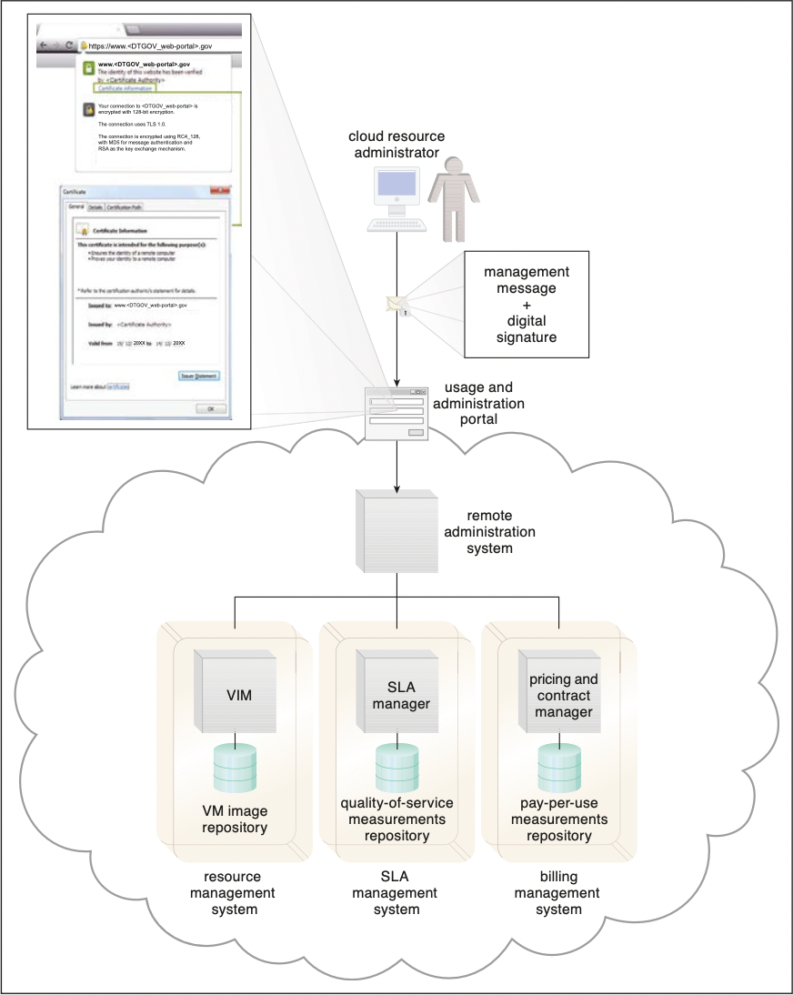
PKI Case Study – DTGOV
•DTGOV requires clients to use digital signatures for access
•Signatures are based on CA-certified public keys
•Example: HTTPS with TLS, RSA key exchange
•Ensures secure access to management systems

Slide 7
What is SSO?
SSO allows users to authenticate once and then use that identity across multiple services. Instead of entering passwords repeatedly, the broker manages authentication tokens across systems.
•Single Sign-On (SSO) = authenticate once, access many services
•Managed by a security broker
•Saves users from multiple logins
•Used in enterprise apps and cloud services

Slide 8
How SSO works
User initiates access
Redirection to the IdP
User authentication
IdP verifies credentials
Token issuance
Token sent back
A user tries to access a web application or service (the Service Provider).
The application redirects the user to the Identity Provider, which is the central authentication system.
The user enters their login credentials into the Identity Provider.
The IdP checks the user's information against its database or an external identity management service to confirm their identity.
Upon successful authentication, the IdP creates a secure, time-sensitive authentication token.
The IdP sends this token back to the user's browser and redirects them to the original application.

Slide 9
Access granted
Subsequent access
The application receives the token, uses it to verify the user's identity with the IdP, and then grants access.
For other applications within the same SSO ecosystem, the user's existing authentication token is presented, allowing them to access these services without another login prompt.

Slide 10
Benefits | Challenges
•Improves usability and efficiency | •Single point of failure if broker is compromised
•Centralized authentication management | •Integration across providers can be complex
•Reduces password fatigue | •Focuses on usability rather than attack prevention

Slide 11
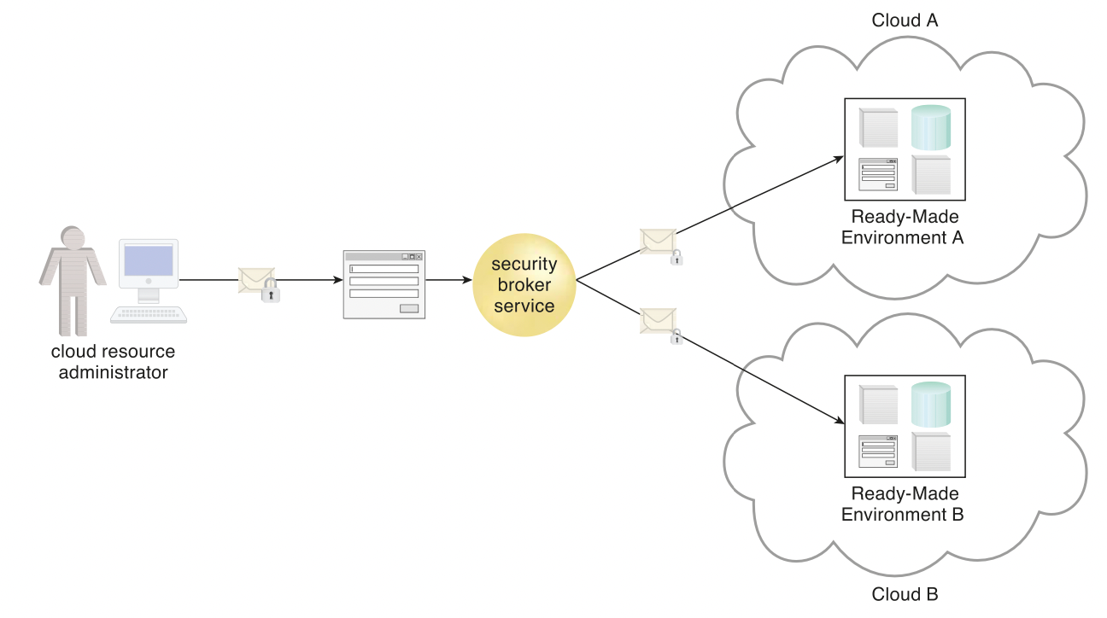

Slide 12
Features | PKI | SSO
Focus | Identity & trust | Usability & access
Tool | Certificates, CAs | Tokens, broker
Strength | Strong security | Seamless access
Weakness | Complex, costly | Single point of failure

Slide 13
Conclusion
PKI ensures identity trust and secure communications
SSO provides ease of use and efficiency
PKI addresses authorization issues, while SSO improves usability
Both are essential in cloud security architectures

Slide 14
Questions
What is the main purpose of PKI?
Who issues digital certificates in PKI?
What does SSO allow a user to do?
What is one major risk of using SSO?
What does the “broker” do in an SSO system?

